Slide 1
Shift Microoperations

Slide 2
Microoperations
A microoperation is an elementary operation performed with the data stored in registers.
The microoperations most often encountered in digital computers are classified into four categories:
  Register transfer microoperations (on binary information)
  Arithmetic microoperations (on numeric data stored in the registers)
  Logic microoperations (bit manipulations on non-numeric data)
  Shift microoperations

Slide 3


Shift Microoperations
Shift microoperations are used for serial transfer of data.
The Shift microoperations that specify a 1-bit shift to the left of the content of register R and a 1-bit shift to the right of the content of register R.
During a shift-left operation the serial input transfers a bit into the rightmost position.
During a shift-right operation the serial input transfers a bit into the leftmost position.
Fig: Shift Left
Fig: Shift Right

Slide 4
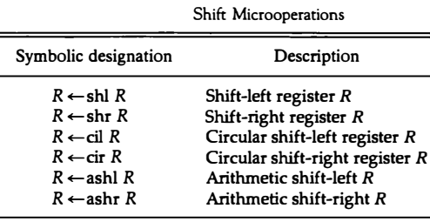
Types of Shift Microoperations
There are three types of shifts Microoperations :
Logical
Circular
Arithmetic

Slide 5

Logical Shift
A logical shift is one that transfers 0 through the serial input.
The symbols shl and shr for logical shift-left and shift-right microoperations.
The bit transferred to the end position through the serial input is assumed to be 0 during a logical shift.

Slide 6
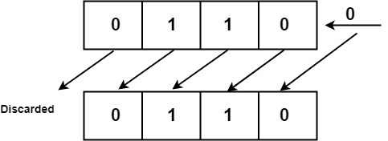
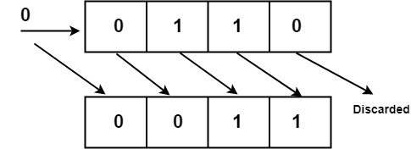
Logical Shift
A logical shift is one that transfers 0 through the serial input.
The symbols shl and shr for logical shift-left and shift-right microoperations.

Slide 7
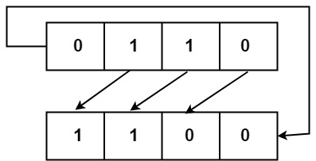
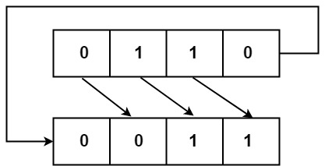
Circular Shift
The circular shift (also known as a rotate operation) circulates the bits of the register around the two ends without loss of information.
This is accomplished by connecting the serial output of the shift register to its serial input.
We will use the symbols cil and cir for the circular shift left and right, respectively.

Slide 8
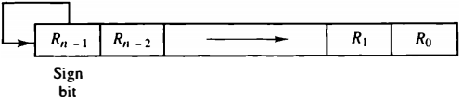
Arithmetic Shift
An arithmetic shift microoperation shifts a signed binary number to the left or right.
An arithmetic shift-left multiplies a signed binary number by 2.
An arithmetic shift-right divides the number by 2.
Arithmetic shifts must leave the sign bit unchanged because the sign of the number remains the same when it is multiplied or divided by 2.
Negative numbers are stored in 2’s complement form.
Fig: arithmetic shift right

Slide 9
Arithmetic Shift
An arithmetic shift microoperation shifts a signed binary number to the left or right.
An arithmetic shift-left multiplies a signed binary number by 2.
An arithmetic shift-right divides the number by 2.
Arithmetic shifts must leave the sign bit unchanged because the sign of the number remains the same when it is multiplied or divided by 2.
Negative numbers are stored in 2’s complement form.
Fig: arithmetic shift right

Slide 10
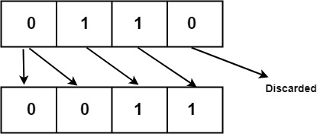
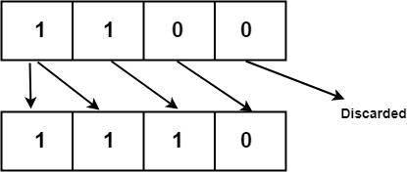
Arithmetic Shift
The arithmetic shift-right leaves the sign bit unchanged and shifts the number (including the sign bit) to the right.
Thus R_{n-1} remains the same, R_{n-2} receives the bit from R_{n-1} " and so on for the other bits in the register. The bit in R₀ is lost.

Slide 11
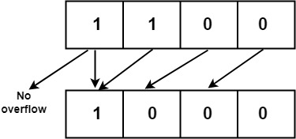
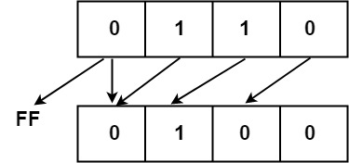
Arithmetic Shift
The arithmetic shift-left inserts a 0 into R₀ and shifts all other bits to the left.
The initial bit of R_{n-1} is lost and replaced by the bit from R_{n-2}.
A sign reversal occurs if the bit in R_{n-1} changes in value after the shift. This happens if the multiplication by 2 causes an overflow.
An overflow occurs after an arithmetic shift left if initially, before the shift, R_{n-1} is not equal to R_{n-2}.

Slide 12

Arithmetic Shift
An overflow flip-flop V_{S}, can be used to detect an arithmetic shift-left overflow.
If V_{S} = 0, there is no overflow, but if V_{S} = I, there is an overflow and a sign reversal after the shift.
V_{S} must be transferred into the overflow flip-flop with the same clock pulse that shifts the register.

Slide 13
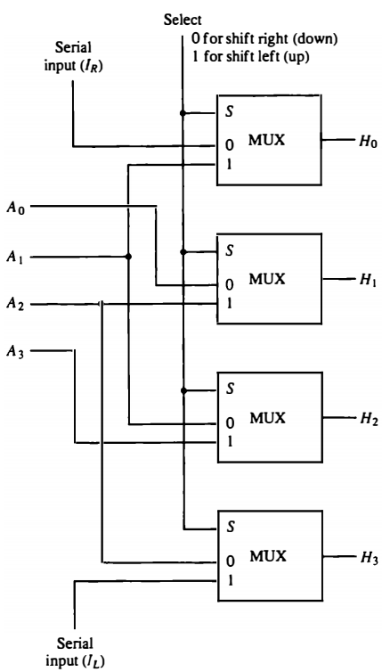
Hardware Implementation
The 4-bit shifter has four data inputs, A₀ through A₃, and four data outputs, H₀ through H₃.
There are two serial inputs, one for shift left (I_{L}) and the other for shift right (I_{R}).
Fig: 4-bit combinational circuit shifter

Slide 14
Hardware Implementation
When the selection input S=0 the input data are shifted right (down in the diagram).
When S = 1, the input data are shifted left (up in the diagram).
A shifter with n data inputs and outputs requires n multiplexers.
Fig: 4-bit combinational circuit shifter

Slide 15
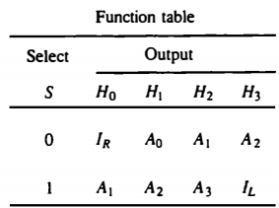
4-bit Combinational Circuit Shifter

Slide 16
Arithmetic Logic Shift Unit
Instead of having individual registers performing the microoperations directly, computer systems employ a number of storage registers connected to a common operational unit called an arithmetic logic unit, abbreviated ALU.
The shift microoperations are often performed in a separate unit, but sometimes the shift unit is made part of the overall ALU.
The arithmetic, logic, and shift circuits can be combined into one ALU with common selection variables.

Slide 17
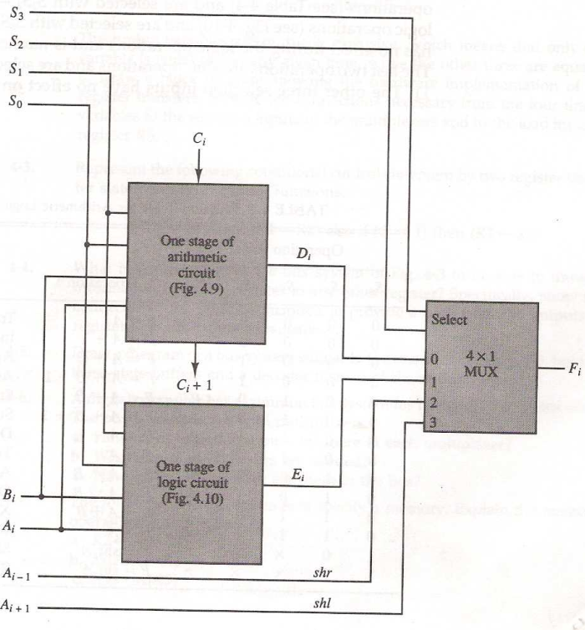
Arithmetic Logic Shift Unit

Slide 18
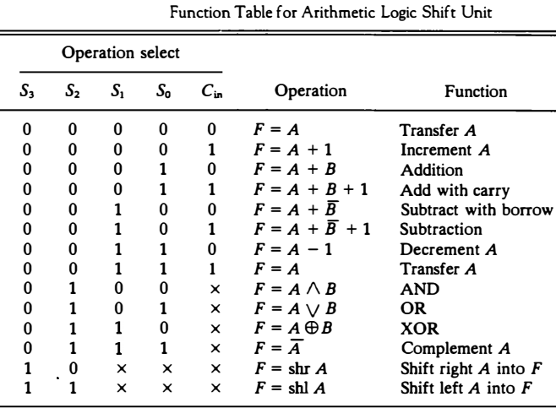
Arithmetic Logic Shift Unit

